Slide 1
ADVANCED MOBILE APPLICATION DEVELOPMENT
HOMEWORK 2
TEAM:
RUMIT SINGH TUTEJA
SWATI JHA
SAKSHI SHRIVASTAVA

Slide 2
Project Description:
Develop a messaging application based on beacons.
User can send and receive messages through the application.
Users can view messages send by other users to him in his inbox.
User can unlock the received messages only he is the proximity of a particular beacon for 10 seconds.
The front end has been developed in android and the back end has been developed using Node JS and Mongo DB.
The back end API have been deployed on amazon EC2.

Slide 3
Back End
The API were developed using Node JS and the database was developed using MongoDB.
Database Schema:
1) var regionSchema = new Schema({ majorminor: {type:String,required:true}, category:{type:String,unique:true,required:true} }, {collection:'region'});
Description:
Collection name: 'region' Columns: A. Majorminor - type:String,required:true B. Category - type:String,unique:true,required:true

Slide 4
2) var userDataSchema = new Schema({ "123:234": {type:String,required:true}, emailID:{type:String,unique:true,required:true}, address:{type:String,required:true}, phoneNo:{type:String, required:true}, password:{type:String, required:true} }, {collection:'users'});
Description: Collection name:'users' Columns: A. Name - type:String,required:true B. emailID - type:String,unique:true,required:true C. password- type:String,required:true

Slide 5
3) var msgSchema = new Schema({ sender: {type:String}, receiver:{type:String}, date: {type:Date}, isRead:{type:Boolean}, isLocked:{type:Boolean}, msg: {type:String}, region:{type:String}, majorminor:{type:String} }, {collection:'messages'});
Description: Collection name: 'messages' Columns: A. Sender - type:String B. Receiver - type:String C. Date - type:Date D. isRead - {type:Boolean E. isLocked - type:Boolean F. Msg - type:String G. Region - type:String H. Majorminor - type:String

Slide 6
Front End
Front end is developed in android.
The user can sign-in and register/sign up.
Once the user in signed in he/she can view the messages that have been sent to him/her by other users from different regions.
The user can reply to those messages or create a new message and send it through any region.
The user can also delete a messages.
Once the user stays in a region for more than 10 seconds all the messages for that region are unlocked.

Slide 7
Front End Design Description:
We have used estimote sdk to fetch the beacon data.
We are using ranging listener to fetch the beacon data.
We have set the scan period as 2 seconds.
We have created a hash map to store the major minor IDs as key and beacon distance as value.
The nearest beacon is stored in a variable and after every 2 seconds we are fetching new beacon and storing in a variable and only if a beacon is fetched twice we are changing the region.
We are also monitoring the distance of the nearest beacon found and only if the distance changes by 1 meter we are changing the region.

Slide 8
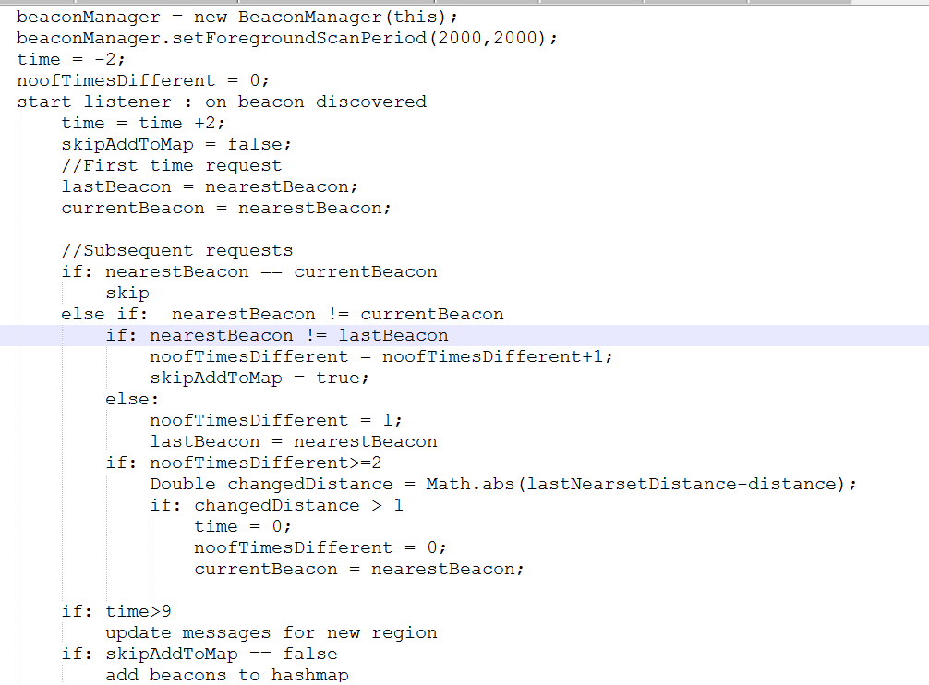
Algorithm:
Math.pow(10d, ((double) measuredPower - rssi) / (10 * 2));

Slide 9
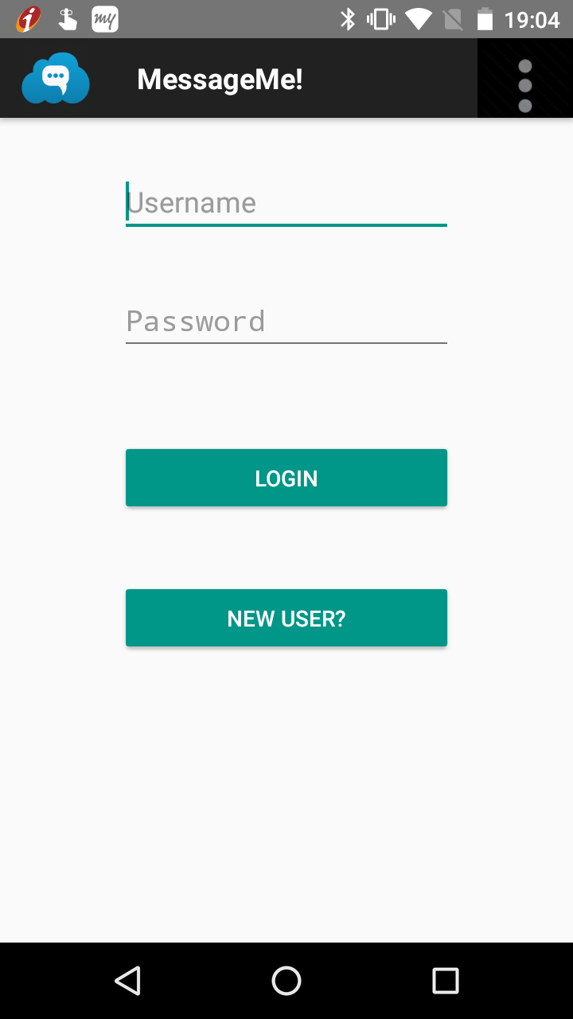
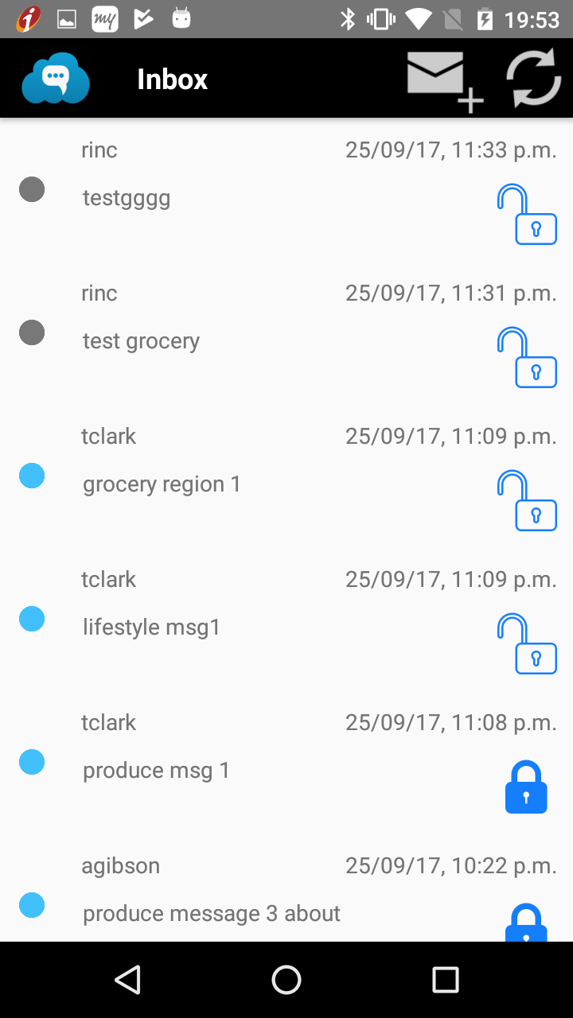
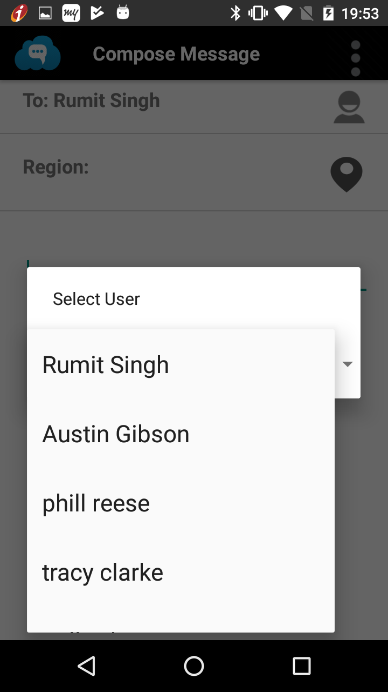
Screen Shots

Slide 10
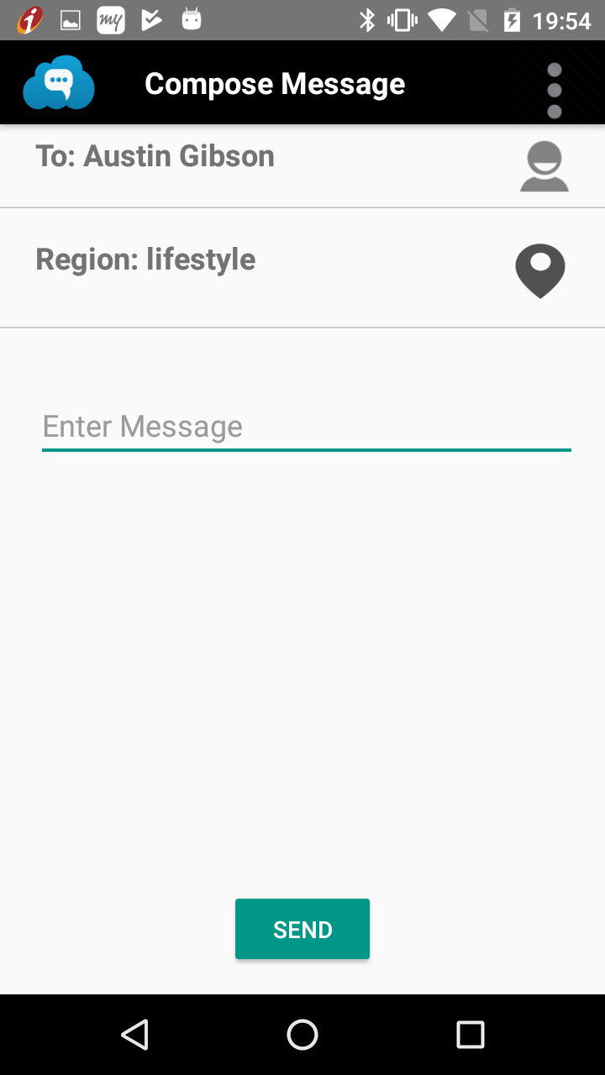
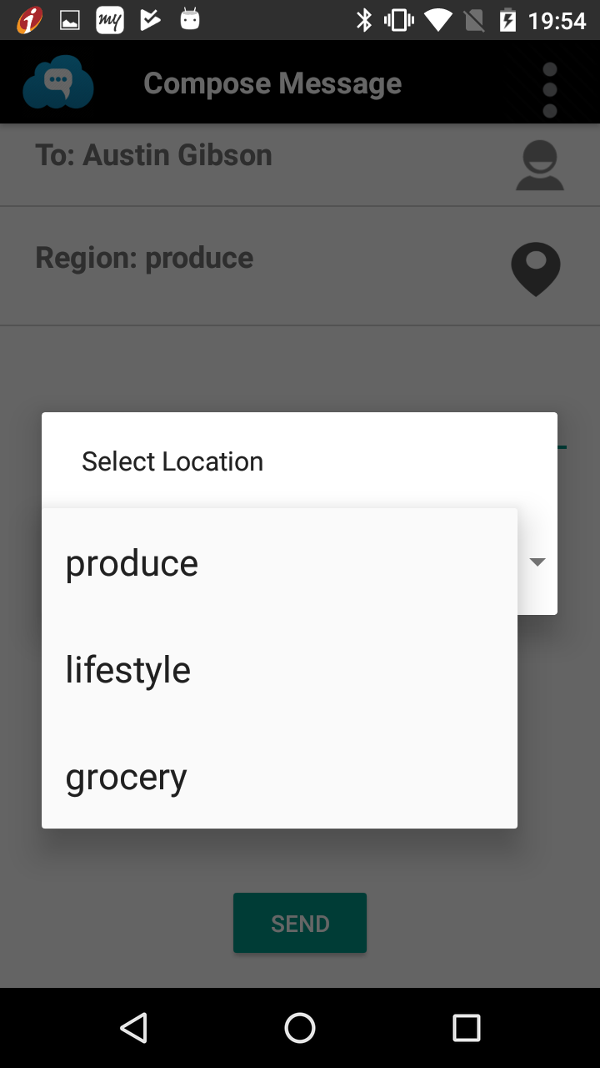
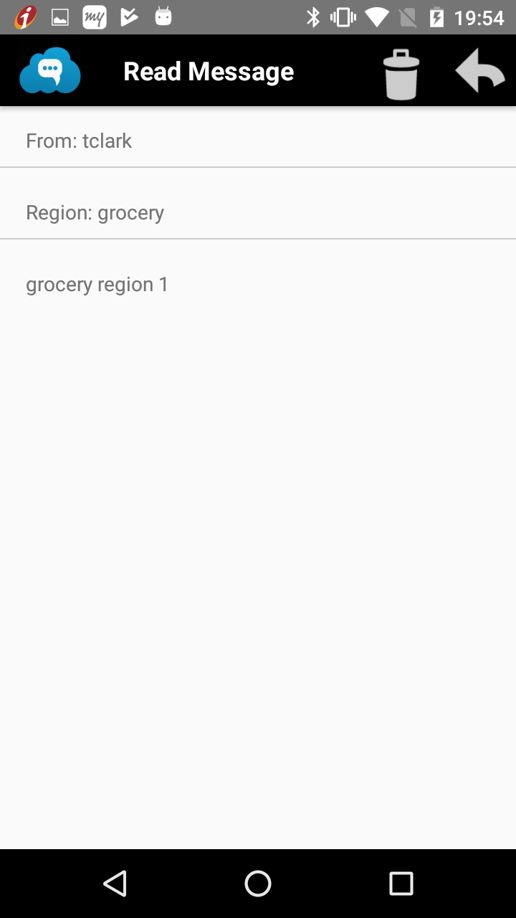

Slide 11
Tasks Completed:
User Sign Up and login.
Loading and parsing messages(Inbox Activity).
Read message activity.
Compose message activity.
EC2 deployment.
JWT token authentication.
Youtube link: https://www.youtube.com/watch?v=idXRhM1NBj8&feature=youtu.be

Slide 12
THANK YOU

